Slide 1
XML
eXtensible Markup Language

Slide 2
XML
Extensible Markup Language
currently version 1.0
Provides a simple, standard, unambiguous structure for describing data
XML is a W3C standard: http://www.w3.org/TR/xml/
Allows us to create our own markup elements (hence it is “extensible”)
Cleanly separates content from presentation
Presentation handled elsewhere, e.g. by XSLT or Javascript

Slide 3
XML Example
<?xml version="1.0" encoding="UTF-8“ ?> <book id="0375411275"> <author>Ben Rice</author> <title>Pobby and Dingan</title> <copyright>2000</copyright> <publisher>Knopf</publisher> <genre>General Fiction</genre> <isbn>0375411275</isbn> </book>

Slide 4
XHTML is XML
<!DOCTYPE html PUBLIC "-//W3C//DTD XHTML 1.0 Strict//EN" "http://www.w3.org/TR/xhtml1/DTD/xhtml1-strict.dtd"> <html xmlns="http://www.w3.org/1999/xhtml"> <head> <title>XHTML is XML</title> <meta http-equiv="Content-Type" content="text/html; charset=UTF-8"/> </head> <body> <h1>XHTML is XML</h1> <p>You’ve been using it all along.</p> </body> </html>

Slide 5
XML Syntax 1 of 4
Some things you already know:
XML elements must close: <p>…</p>, <br/>
XML tags are case sensitive: <h1> is not <H1>
Attribute values must be quoted: <div id=“footer”>…</div>
<!-- comments look like this -->

Slide 6
XML Syntax 2 of 4
Some things you’ve probably figured out:
Some characters are reserved: < &
and should be replaced by entities: &lt; &amp;
you should also replace the > sign: &gt;
replacing “ and ‘ is often good: &quot; &apos;
XML documents form a tree and must have a root element, e.g. <html>…</html>

Slide 7
XML Syntax 3 of 4
Some new things to know about tags:
Tags must be alphanumeric (or underscore _ )
Must begin with a letter (or underscore _ )
No spaces in tag names
Attribute names must be alphanumeric (only)

Slide 8
XML Syntax 4 of 4
Suggestions for tags:
Use descriptive, meaningful tag names <n> ??? → <courseNumber>
Use camel case <camelCaseIsEasyToReadWhenYouCantUseSpaces/>
Avoid the underscore

Slide 9
XML in Practical Use
XHTML
RSS
ATOM
RDF
etc...
SOAP
WSDL
SVG
XSLT
Arbitrary XML

Slide 10

Example
http://events.rpi.edu/
Notes:
http://events.rpi.edu/cal/main/showEventList.rdo;jsessionid=C910E413B242FE450E5F703B2B8A9C52#exportSubscribePopup

Slide 11
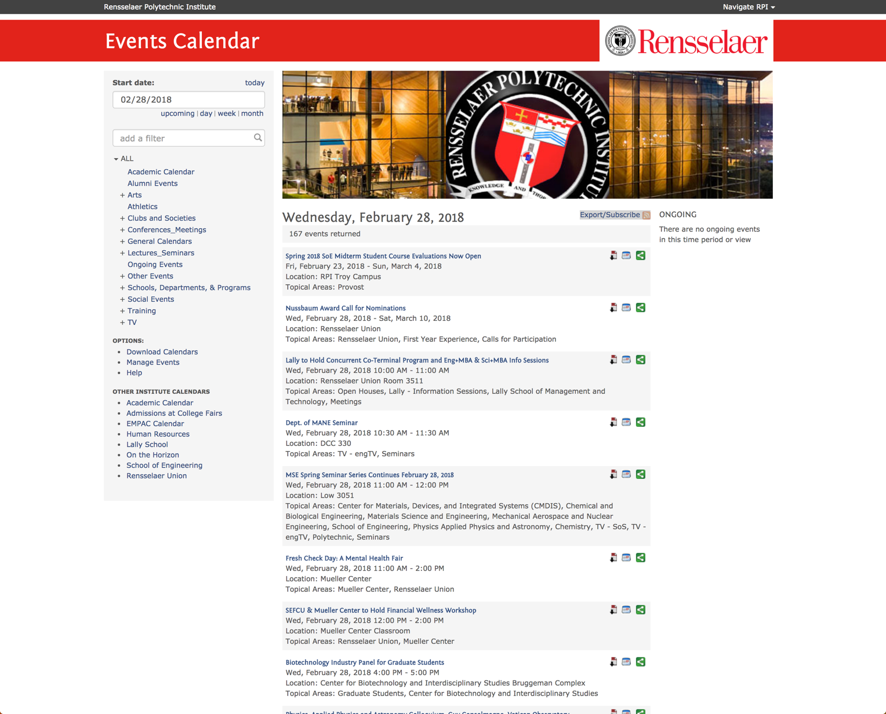
Example
http://events.rpi.edu/
Notes:
http://events.rpi.edu/cal/main/showEventList.rdo;jsessionid=C910E413B242FE450E5F703B2B8A9C52#exportSubscribePopup

Slide 12
Basic Format
XML Declaration
Document Type Definition (DTD) with optional PUBLIC and SYSTEM identifiers, e.g. <!DOCTYPE HTML PUBLIC "-//W3C//DTD HTML 4.01//EN" "http://www.w3.org/TR/html4/strict.dtd">
Document markup

Slide 13
Basic Format
Example:
1. <?xml version="1.0" encoding="UTF-8“ ?> 2. <!DOCTYPE book SYSTEM "book.dtd"> 3. <book id="0765323117"> <author>Cory Doctorow</author> <title>Little Brother </title> <copyright>2008</copyright> <publisher> Tom Doherty Associates,LC </publisher> <genre>General Fiction</genre> <isbn>0765323117</isbn> </book>

Slide 14
Basic Format
XML Declaration
<?xml version="1.0" encoding="UTF-8" ?>
Document Type Definition (DTD) <!DOCTYPE book SYSTEM "book.dtd”>
DTD defines the syntax of the document type in use
Allows for validity checking (e.g. validating XHTML 1.0)
PUBLIC identifier expresses what kind of document it is (as an FPI)
SYSTEM identifier specified the location of the DTD (as a URI)
(Note: XML Schema is an alternative to DTDs...)
Neither a DTD nor a schema is required
Document markup

Slide 15
From this...
<!DOCTYPE html PUBLIC "-//W3C//DTD XHTML 1.0 Strict//EN" "http://www.w3.org/TR/xhtml1/DTD/xhtml1-strict.dtd"> <html xmlns="http://www.w3.org/1999/xhtml"> <head> <title>XHTML is XML</title> <meta http-equiv="Content-Type" content="text/html; charset=UTF-8"/> </head> <body> <h1>XHTML is XML</h1> <p>You’ve been using it all along.</p> </body> </html>

Slide 16
To something a bit more XMLish...
<?xml version="1.0" encoding="UTF-8" ?> <!DOCTYPE html PUBLIC "-//W3C//DTD XHTML 1.0 Strict//EN" "http://www.w3.org/TR/xhtml1/DTD/xhtml1-strict.dtd"> <html xmlns="http://www.w3.org/1999/xhtml"> <head> <title>XHTML is XML</title> </head> <body> <h1>XHTML is XML</h1> <p>You’ve been using it all along.</p> </body> </html>

Slide 17
Namespaces 1 of 2 <html xmlns="http://www.w3.org/1999/xhtml">
What is a Namespace?
Per Wikipedia: In XML, the XML namespace specification enables the names of elements and attributes in an XML document to be unique, similar to the role of namespaces in programming languages. Using XML namespaces, XML documents may contain element or attribute names from more than one XML vocabulary.
A way of separating sets of tags from different taxonomies (different DTDs) to prevent collisions
<nut> ...is this hardware or food?
<hardware:nut> and <food:nut> tell us which definition to use

Slide 18
Namespaces 2 of 2
The namespace declaration we see in the html tag defines the default namespace for the document: <html xmlns="http://www.w3.org/1999/xhtml">
Declared as an attribute of a tag and used within the element defined: <rss xmlns:atom="http://www.w3.org/2005/Atom"> <atom:link rel="self" href="http://thisfeed" type="application/rss+xml"/> </rss>

Slide 19
Microformats
Add semantic meaning to (x)html documents
Add machine readable definition (meaning) to human readable content
Provides for the machine (non-human) consumer
hCard
hCalendar (iCal superset)
Atom (subset proposed as hAtom)
RSS (older, stable, still widely used)
Rich Site Summary – aka – Really Simple Syndication

Slide 20
Web Syndication
RSS and Atom are common XML microformats used for providing data feeds of news, blogs, forums, and other information on the web
Both are simple to construct
RSS (~1995)
older, more ubiquitous, version 2.0 is most common
Atom
newer, more modular and extensible, at version 1.0
written to address perceived weaknesses of RSS (not the least of which was that RSS is a frozen standard ...even though namespaced elements are fine to use)

Slide 21
Example (revisited)
http://events.rpi.edu/
Notes:
http://events.rpi.edu/cal/main/showEventList.rdo;jsessionid=C910E413B242FE450E5F703B2B8A9C52#exportSubscribePopup

Slide 22
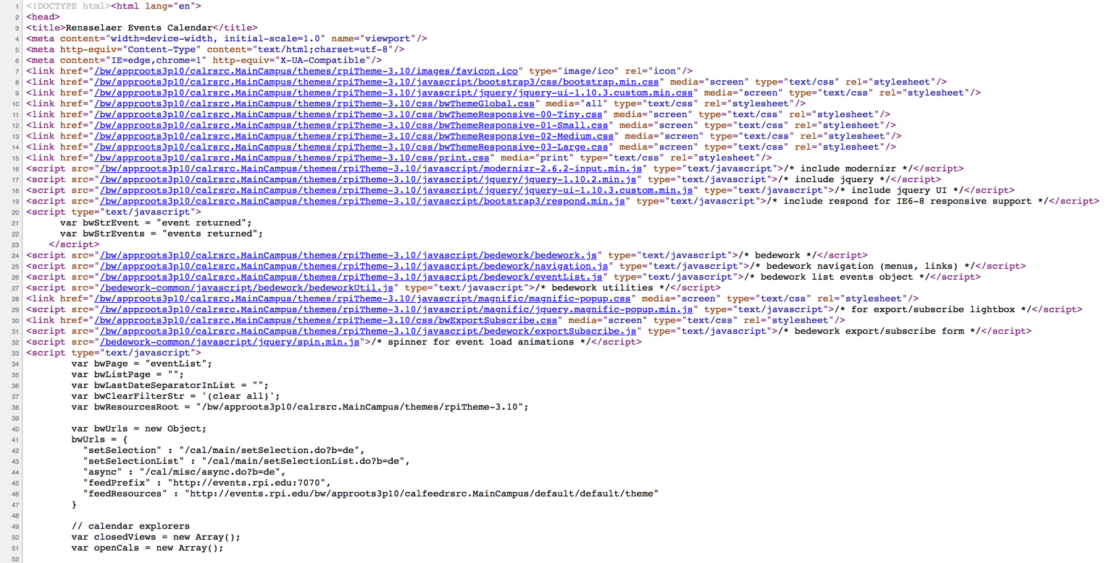
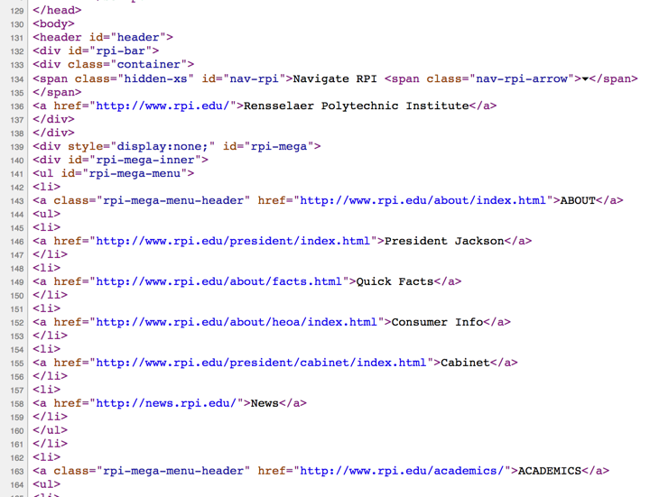
Example – HTML 5
http://events.rpi.edu/

Slide 23
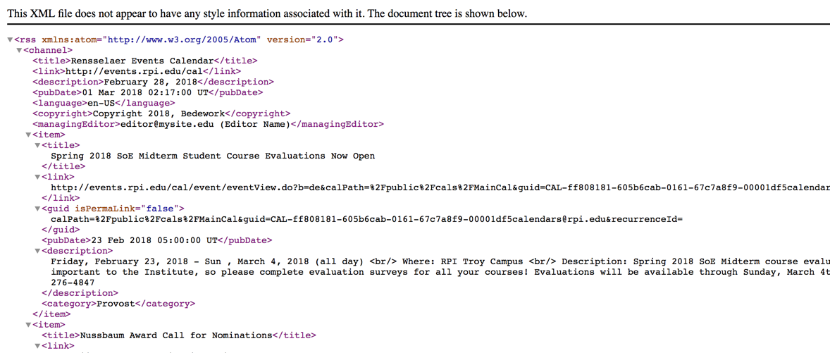
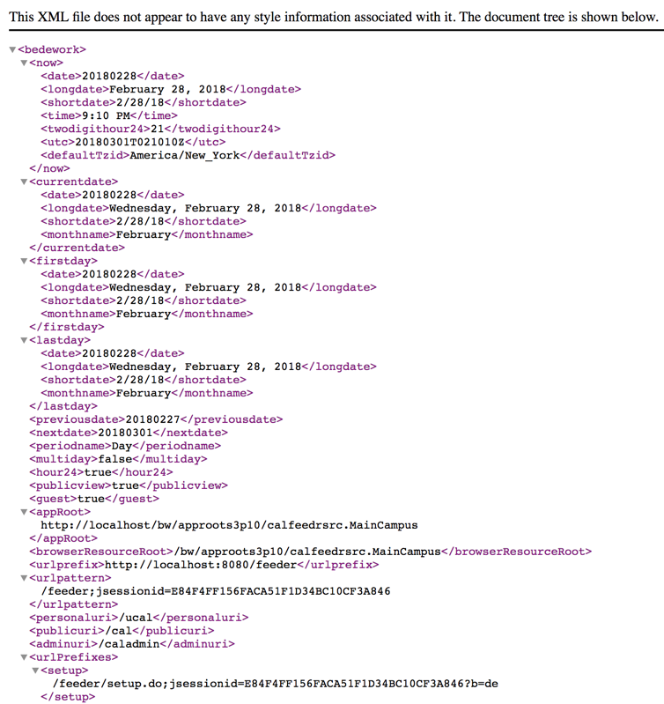
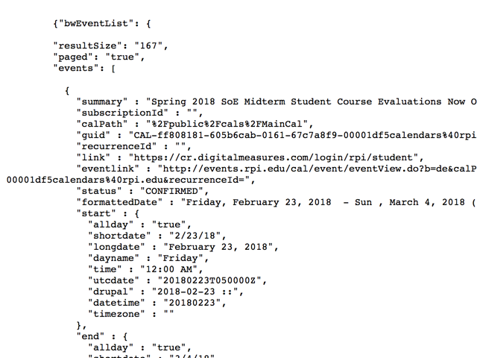
Example – XML, JSON, RSS
http://events.rpi.edu/
Notes:
RSS : http://events.rpi.edu:7070/feeder/main/eventsFeed.do?f=y&sort=dtstart.utc:asc&fexpr=(categories.href!=%22/public/.bedework/categories/Ongoing%22)%20and%20(entity_type=%22event%22%7Centity_type=%22todo%22)&skinName=list-rss&count=10
XML : http://events.rpi.edu:7070/feeder/main/eventsFeed.do?f=y&sort=dtstart.utc:asc&fexpr=(categories.href!=%22/public/.bedework/categories/Ongoing%22)%20and%20(entity_type=%22event%22%7Centity_type=%22todo%22)&skinName=list-xml&count=10
JSON : http://events.rpi.edu:7070/feeder/main/eventsFeed.do?f=y&sort=dtstart.utc:asc&fexpr=(categories.href!=%22/public/.bedework/categories/Ongoing%22)%20and%20(entity_type=%22event%22%7Centity_type=%22todo%22)&skinName=list-json&count=10

Slide 24
Example (revisited)
http://events.rpi.edu/

Slide 25
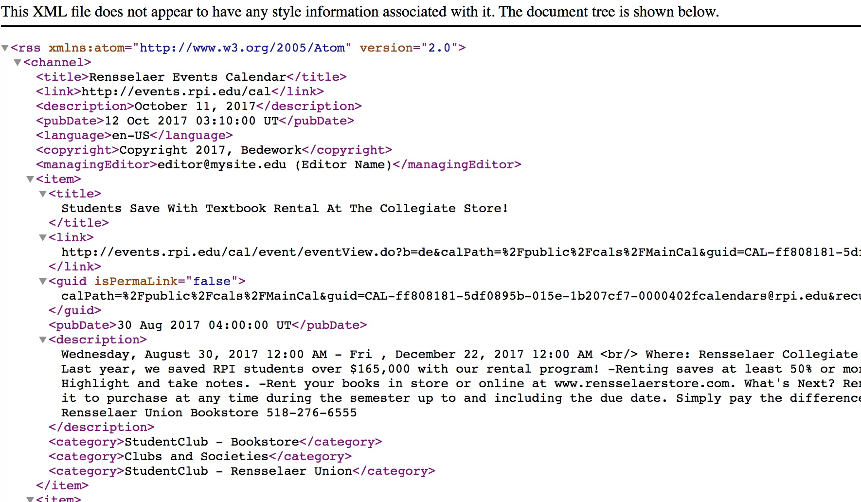
Example (revisited)
http://events.rpi.edu:7070/feeder/main/eventsFeed.do?f=y&sort=dtstart.utc:asc&fexpr=(categories.href!=%22/public/.bedework/categories/Ongoing%22)%20and%20(entity_type=%22event%22%7Centity_type=%22todo%22)&skinName=list-rss&count=10

Slide 26
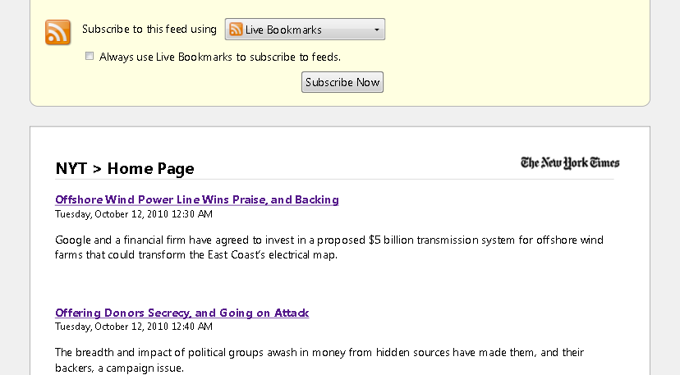
Example RSS: New York Times

Slide 27
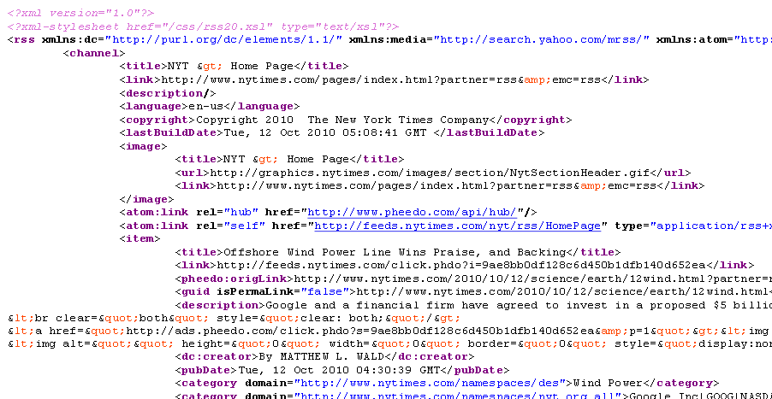
Example RSS: New York Times

Slide 28
Learning RSS and Atom
RSS http://www.w3schools.com/xml/xml_rss.asp
Atom http://www.atomenabled.org/developers/syndication/
View feeds in a reader:
Browsers (all modern browsers can handle RSS/Atom feeds)
Use an online aggregator/reader (e.g. Google reader, Facebook, Yahoo, etc.)
Use a desktop mail client (most have readers, e.g. Outlook, Thunderbird, etc.)
Download a feed reader for your platform (there are many)

Slide 29
Lab 4: XML
Create two XML files, one RSS 2.0 and one ATOM 1.0
Guidelines:
Create three items/entries, each linking to a news or blog posting, or any web content you find interesting (from three different web sites).
You may use the same three items in both feeds.
The feeds must validate. http://validator.w3.org/feed/#validate_by_input
Post the two files onto your projects page of your Class (lab4) website.
Post a working link to your project page in the lab README.md file.
Zip your lab4 files and upload them to LMS, named yourRCSID-Lab4.zip
You will be graded on validity (5 pts), indentation (2 pts), completeness (3pts)

